Slide 1
Why Structured Recess?
Bona Vista Elementary School

Slide 2
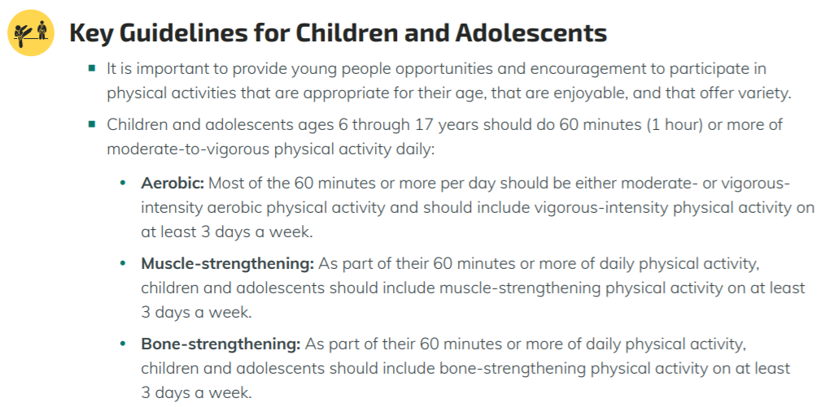
What do experts recommend for physical activity?
The US Department of Health and Human Services recommends that children ages 6-17 years engage in at least 60 minutes of moderate to vigorous physical activity per day⁴.

Slide 3
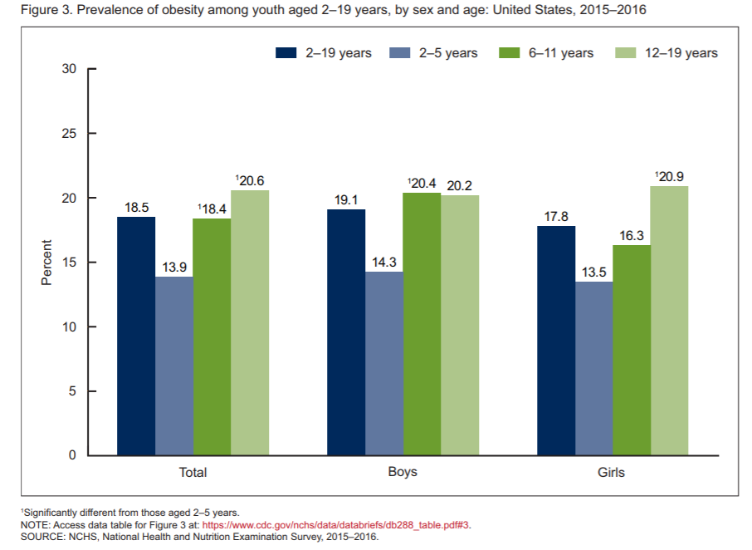
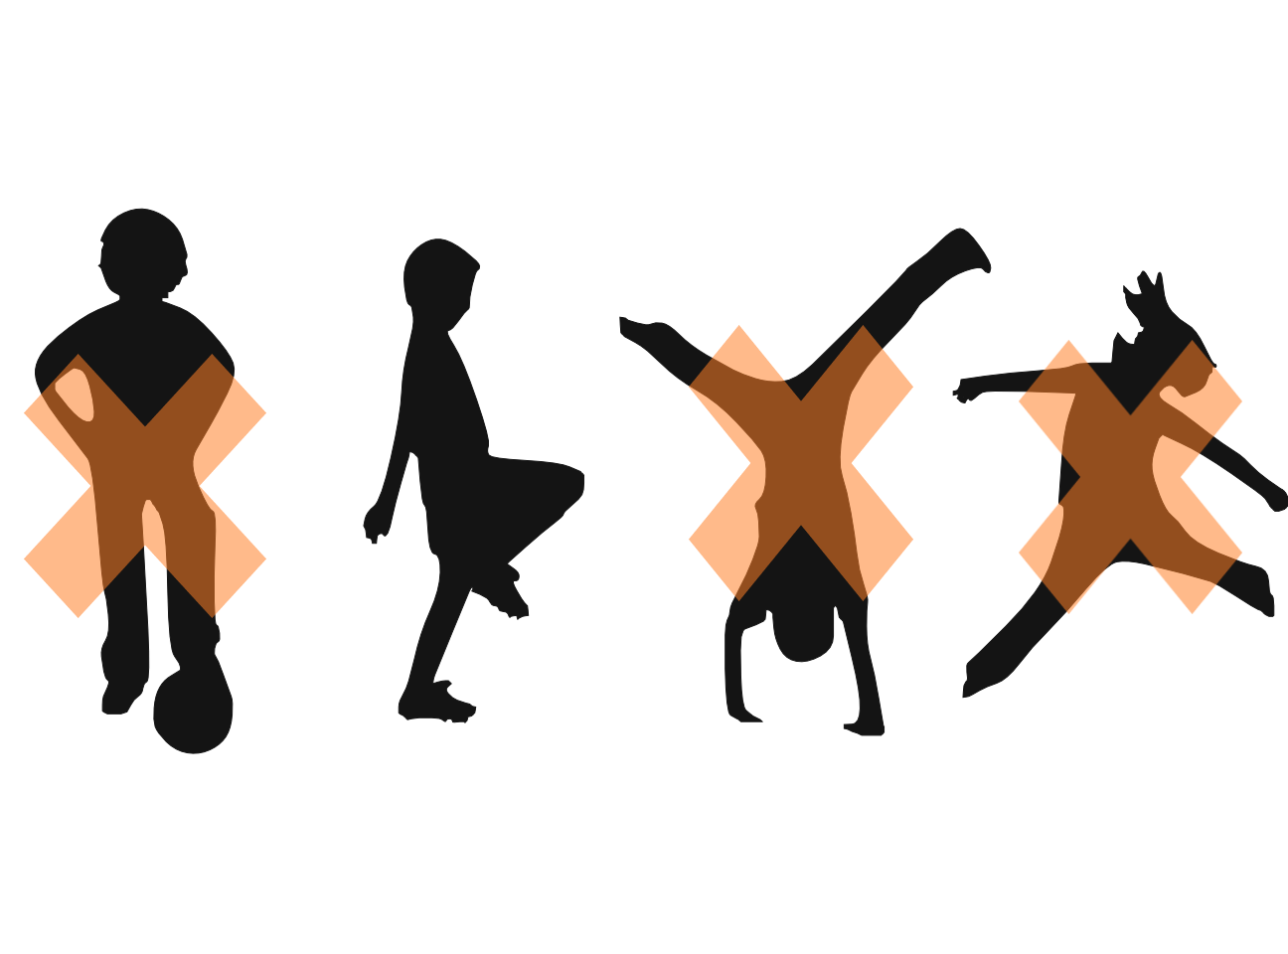
The health of our children
Only 24% of children meet the guidelines of 60 minutes of physical activity (PA) per day.
About 1 in 5 school-aged children are obese
About 3 in 4 do NOT meet PA guidelines.

Slide 4
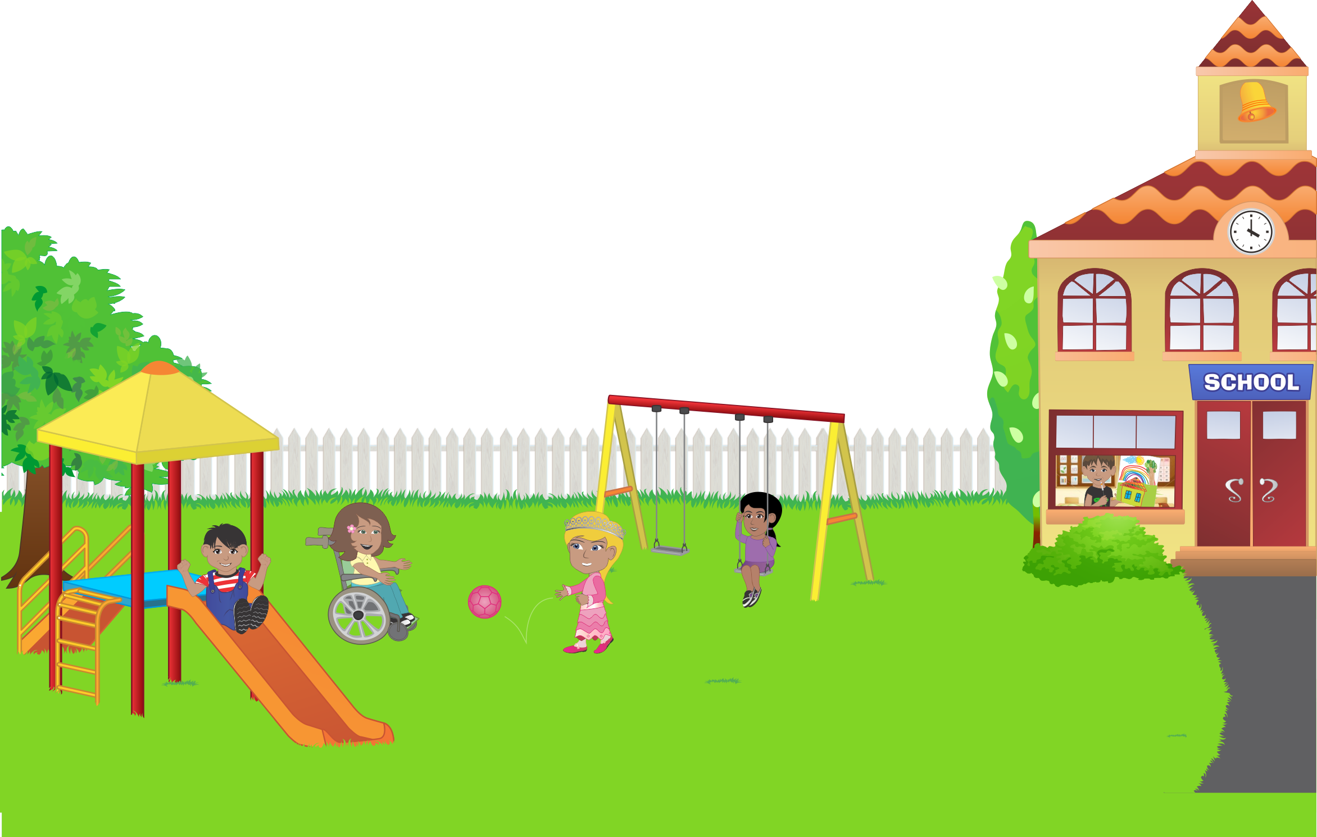
What do experts recommend for recess?
Organizations, including American Academy of Pediatrics (AAP), Centers for Disease Control and Prevention (CDC), and Institute of Medicine (IOM), recommend that all schools require at least 20 minutes of recess daily.

Slide 5
Impact on Health
Recess allows students to take a break from their academic routine.
Recess provides an opportunity for children to meet the goal of 60 minutes of activity per day.
Through physical activity and free play, recess can improve children’s physical, social, and emotional health^{1,2}.
Recess may benefit learning in the classroom, through improved attention, focus, and positive behavior³.

Slide 6
Recess Plan
The VISION of Bona Vista Elementary School Recess is to provide a space every day for students to move and be physically active in a safe environment where they can socialize with their peers.
The GOALS of Bona Vista Elementary School Recess are:
To increase students’ physical activity levels
To encourage free play and structured play at every recess
To provide a safe place for students’ to interact with each other outside of the classroom
Notes:
These are some significant goals we have outlined for recess. If you have any other thoughts about our goals for recess, we can discuss those at the end of the presentation. We truly want our vision and goals to come to life. To do this, we must make some changes.

Slide 7
New Recess Strategies
Zone Mapping
New blacktop markings
New equipment
Activity Cards
Zone & Activity Schedules
Notes:
These new recess strategies will help us meet our recess goals. I will elaborate on these strategies in the following slides.

Slide 8
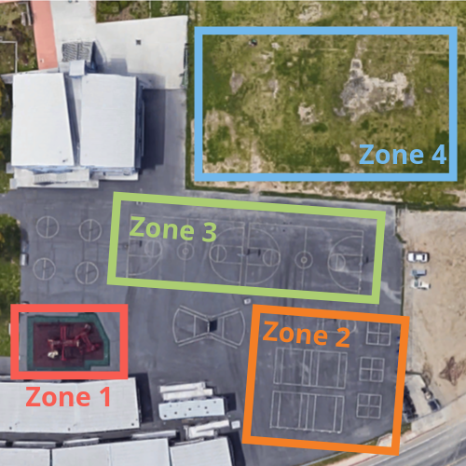
Zone Mapping
Zone 1 = Playground
Zone 2 = Small group blacktop games
Zone 3 = Large group blacktop games
Zone 4 = Field games
Notes:
This visual is a satellite image of our outdoor recess space. We have come up with 4 zones where students can choose to play at recess. Zone 1 is the playground structure. This zone is free play and may have optional stretching and flexibility exercises the students can do if they please. Zone 2 is for small group blacktop games. Games, such as four square, can be played here. As well, equipment can be set out for students to free play with in this zone. Zone 3 is for large group blacktop games or equipment free play. Zone 4 is for group field games. These zones should allow for free play and structured game options, providing the space for physical activity that every student can enjoy.

Slide 9
Activity Cards
Activity cards provide games, stretching/flexibility exercise, and introductions to new play equipment or new sports
Activity cards will be used in some zones at recess as a way to encourage physical activity
Not every zone will have a structured game via an activity card
Activity card use will be based on supervisor:student ratio
Students may choose whether to engage in a structured game via an activity card or to engage in free play with equipment or the playground

Slide 10
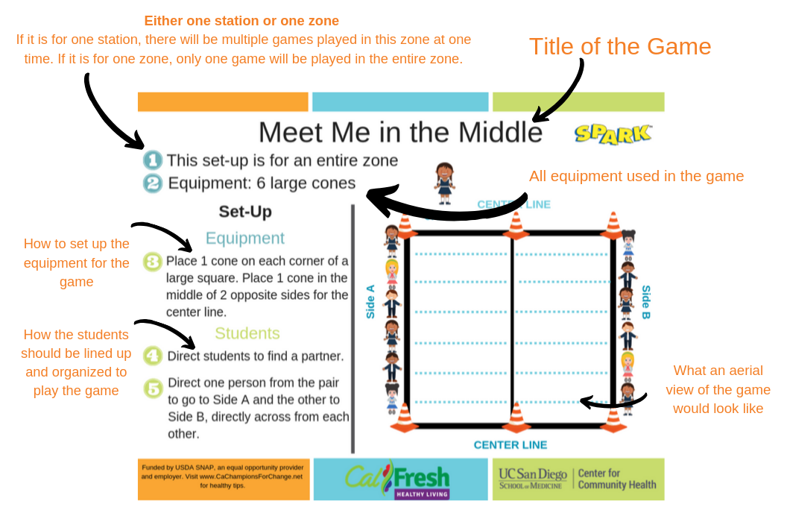
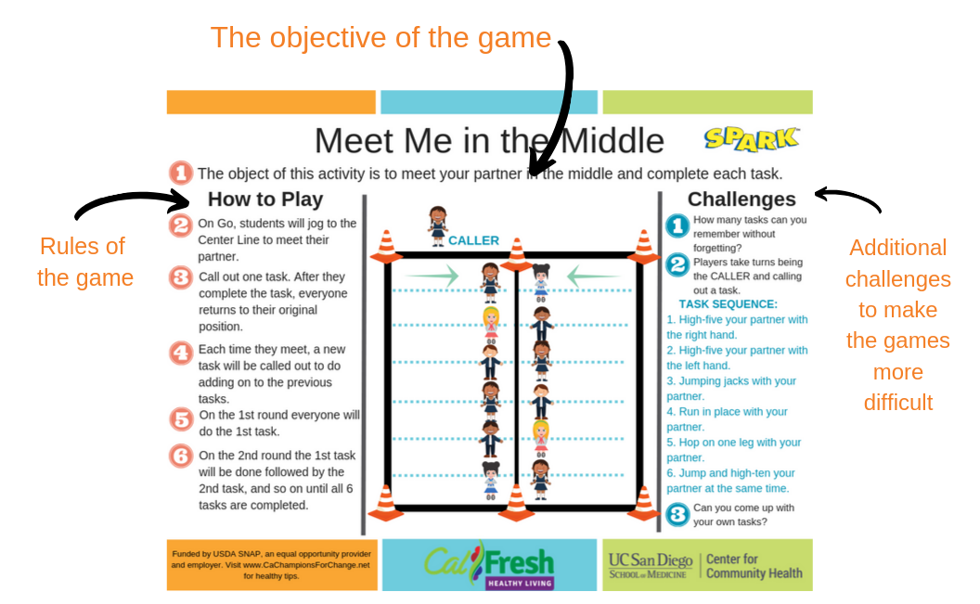
Activity Card Example
FRONT
BACK
Notes:
This is an example of an activity card. It is a game called “Meet Me in the Middle.” The card has instructions for game set up and rules for how to play, easy enough for students to read and understand. These will be set out in certain zones at recess.

Slide 11
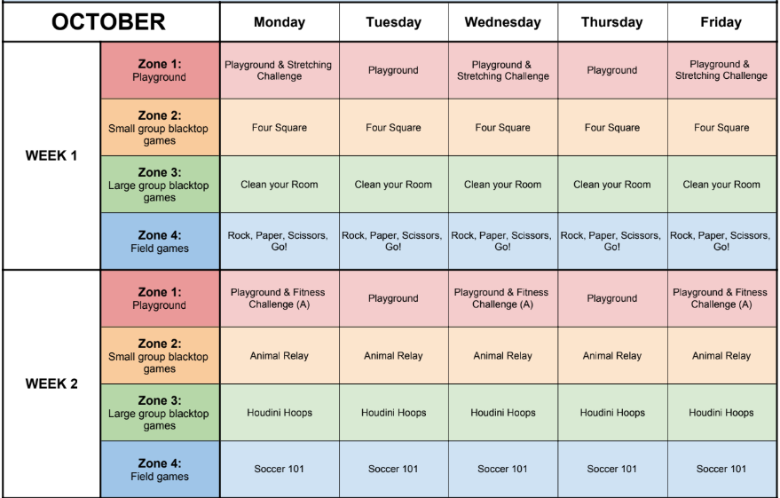
Recess Activity Schedules
This is a sample zone and activity card schedule.
New activity cards are used each week in each zone.
Notes:
This sample schedule shows only the first 2 weeks of the month, so that you can get an idea of how a rotating schedule will work with zones and activity cards.

Slide 12
Introducing the New Strategies
Recess Supervisor and Staff Recess Trainings
Introduction to new recess strategies - zones, activity cards, scheduling
Behavior management and conflict resolution training, includes role play
TIMING: the week before school begins
Student Assembly
Review of encouraged recess behaviors and expectations
Modeling conflict resolution
Introduction to new recess strategies - zones and activity cards
TIMING: 1st week of school

Slide 13
References
1.Ramstetter CL, Murray R, Garner AS. The crucial role of recess in schools. Journal of School Health 2010;80:517-526.
2.American Academy of Pediatrics. Policy Statement: The Crucial Role of Recess in School. Pediatrics 2013;131:183-188.
3.Centers for Disease Control and Prevention. The Association between school-based physical activity, including physical education, and academic performance. Atlanta, GA: U.S. Department of Health and Human Services; 2010.
4.U.S. Department of Health and Human Services. 2008 Physical Activity Guidelines for Americans.

